Slide 1
Project Presentation on e-Learning Website Management
Rubiat Hasan Khan
Roll No.:1909014

Slide 2
What is an e-Learning website?
An e-learning website is an online platform that provides a virtual environment for individuals to access educational content, courses, and resources over the internet. These websites have revolutionized traditional education by offering a flexible and convenient way for learners to acquire knowledge, skills, and expertise from the comfort of their own homes or virtually anywhere with an internet connection.
E-learning websites typically offer a variety of features and services, some key features are:
Online Courses
Progress Tracking
Flexibility
Certification
Access to Experts

Slide 3
First name
ID
Gender
ID
Name
Title
ID
Course Id
Last name
Student
Teacher
Has
Course Video
Video file
Address
Belong
Course Id
Question
View
ID
Option 01
ID
Course Id
ID
Has
Quiz
Option 02
Name
Credit
Student Id
Course
Score
Correct answer
Option 03
Result
Type
Teacher Id
Total item
Option 04
Date
Contain
Has
Course Pdf
Pdf file
ER Diagram
ID
Course Id

Slide 4
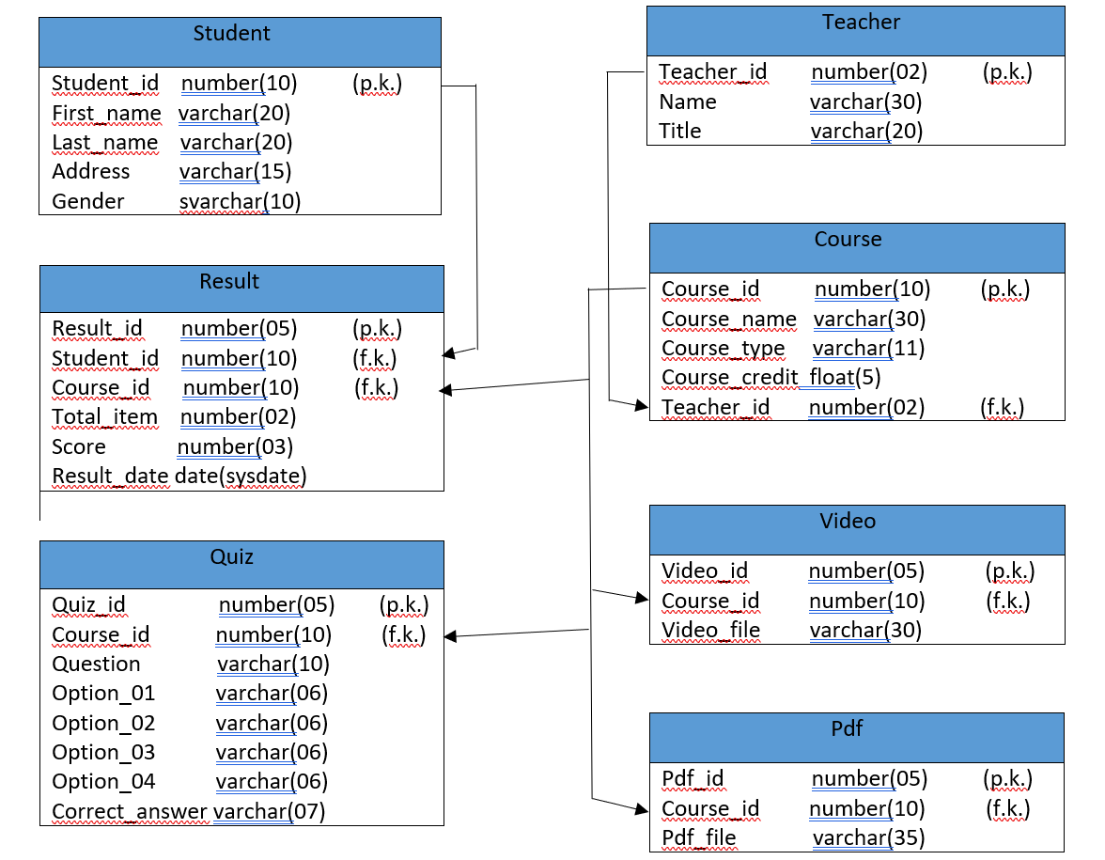
Schema Diagram

Slide 5
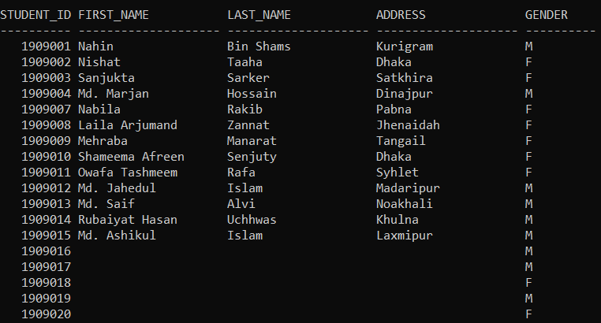
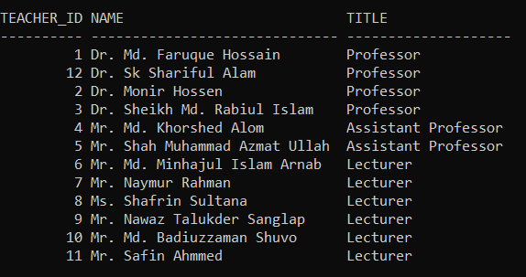
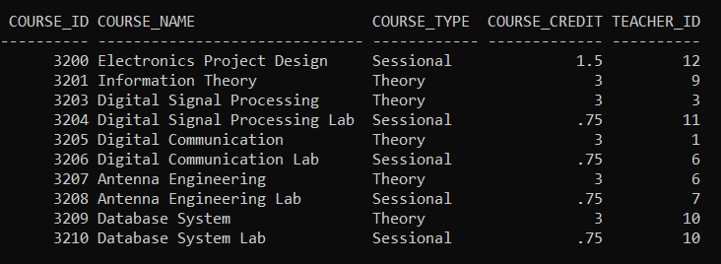
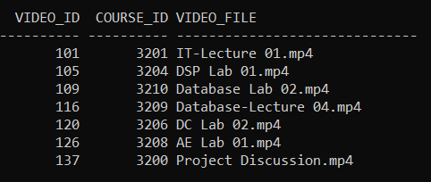
Tables…
Student Table Teacher Table
Course Table Videos Table

Slide 6
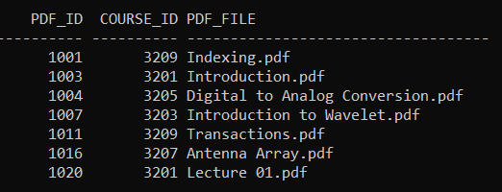
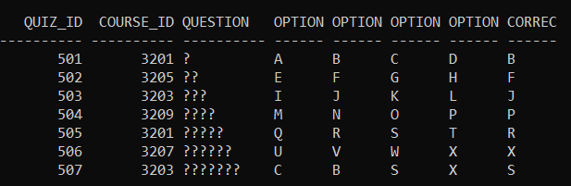
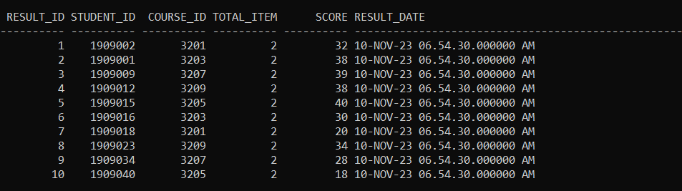
Tables…
PDF Table Quiz Table
Result Table

Slide 7
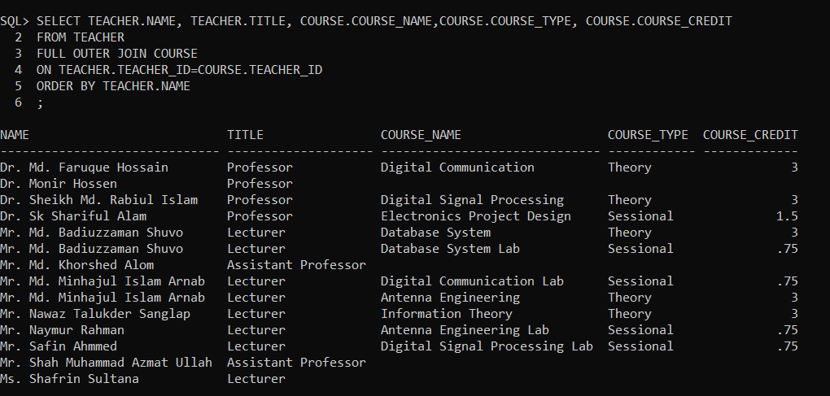
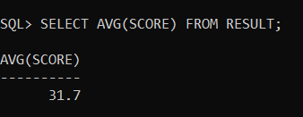
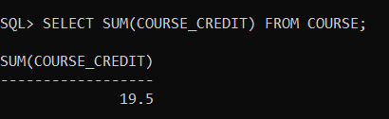
Some Query Examples…
Full Outer Join: Finding Average Score:
Total Course Credit

Slide 8


